Slide 1


Open Data and Knowledge Graphs
Group 04
Members: JIAYI LIN
WIDAD EL ABBASI
AZIZ NABIL
Notes:
Our presentation consist of

Slide 2
Contents
Data Preparation
Resource Naming Strategy
Ontology
Data Linking
Application
Notes:
This presentation is divided to 5 parts : ….
ontology : describing the concepts of our domain and the different relationships that exist among them
after ontology we pass to transform our data to the RDF format, using protoge
last part : linkinf data with other datasets on the web using lodrefine

Slide 3
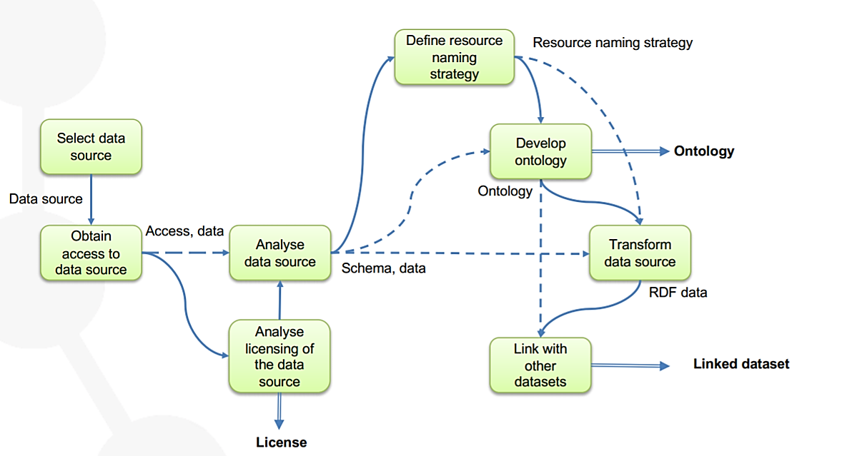

Linked data generation process
Notes:
linked data generation process : has the goal of representing a data source using RDF format and linking those data to others existing in the web.
So achieve this , we will follow this chart step by step
And we begin with preparing and analysing the data we want to transform to linked data
So we choosed a dataset, one that can easily be linked with other datasets through semantics queries, the one that we choose revolves about hospital informations, it includes hospital addresses, city, state, county , hospital type, and overall hospital rating.

Slide 4
Data Preparation
Select data source :
Smart cities domain
Obtain access to data source :
Data are available as a CSV file ( Hospital_General_Information-csv )
Analyse licensing of the data source :
The dataset has an Open licence and it is owned and published by Centers for Medicare &amp; Medicaid Services.
Analyse data :
Data characteristic and schema
Notes:
The first step in data preparation is to select the data source. that satifies our requierement/ and then we verify if each requirement is satisfied
Licence as we can see here the rightholder is the same as the publisher so we would not have a problem in this stage
Analyze data : here we will try to analyse the dataset information since no description was provided with the dataset
=> and another thing we need to ensure is if this dataset have features that can be linked with others through the web , which is the case : our dataset contains informations about cities, countys and hospital exact addresses. Which can easily be found in others as we will see at the end of this presentation
, so yes ; The dataset contains several information that can be easily linked with other real entities

Slide 5
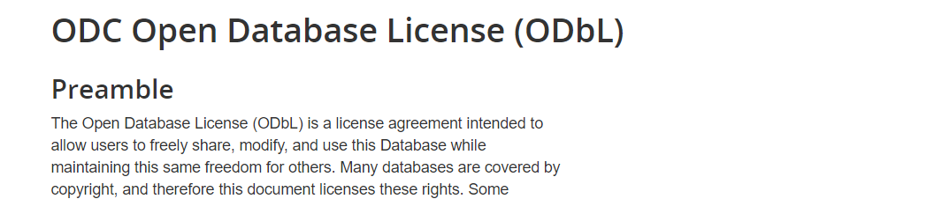
oPEN DATABASE LICENCE
Notes:
licence : as we can see, while analyzing this licence we find firt that the authorized publisher is the same as the data rightholder. and that it allows us to use the dataset /data open
And it allows us to use, re-use and publish this dataset

Slide 6
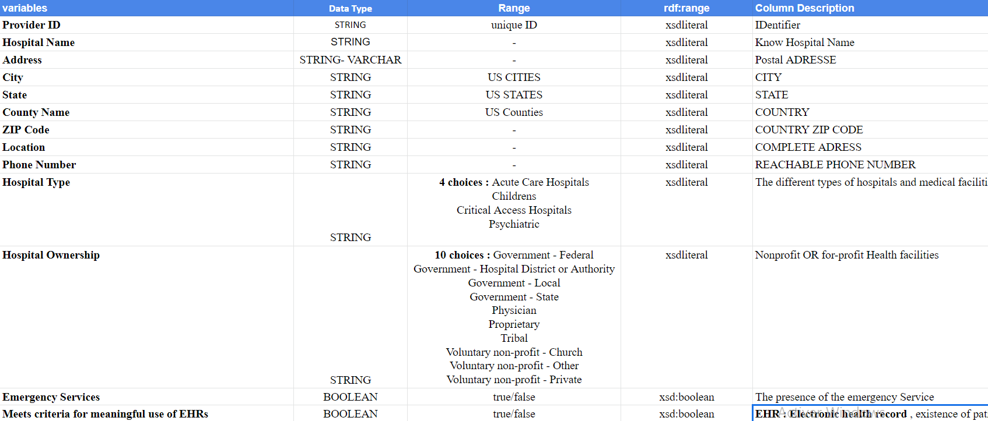
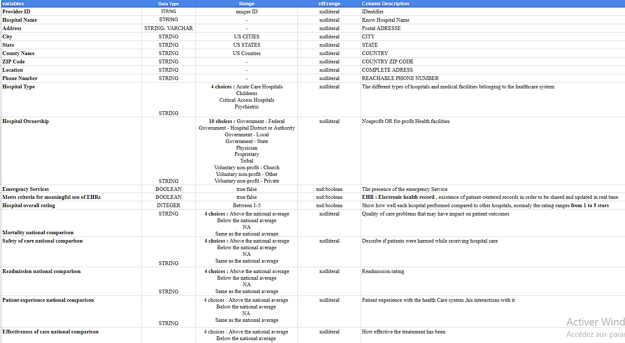
Analysis of DataSet
Notes:
As for the analyze of our data ,
We summarized the information in a table that identify the content of each feature( a total of 23 ) and its data type, the description provide explanation about the role of each variable in our dataset.
now we pass to the data structe, so we analyse the characterictics of the data : data type, range, content so we can understant the meaning of each feature so we can create the schema of the data.
Goal : to extend the web

Slide 7
Linked data generation process

Slide 8
Resource NAMING STRATEGY
Domain: http://www.smart-city.GP04-LDATA.org/
Ontological
Individual
Individual path:
http://www.smart-US.GP04-LDATA.org/US/resource/
Individual pattern:
http://www.smart-US.GP04-LDATA.org/US/resource/<resource_name>
Ontological term path :
http://www.smart-US.GP04-LDATA.org/US/ontology/Hospital_general_informations#
Ontological term pattern:
http://www.smart-US.GP04-LDATA.org/US/ontology/Hospital_general_informations#<term_name>
Notes:
Now I’d like to look at defining our ressource naming strategy, means we gonna give unique identifiers to our ressources (/URIs/IRIs) , so we can begin the developement of our entology
following the instructions in the course define path for ontogy and individuals and after we define the URI patterns also for bith terms
-hash for ontology
-slash for individuals
URIs define only a single ressource
Individual term patterns Example:
- http://www.smart-US.GP04-LDATA.org/US/resource/hashospital_Type/AcuteCareHospitals
Ontological term patterns Example:
- http://www.smart-US.GP04-LDATA.org/US/ontology/Hospital_general_informations#Hospital
Which lead us to next part which is ontology

Slide 9
Ontology
Class
Data properties
Object properties

Slide 10
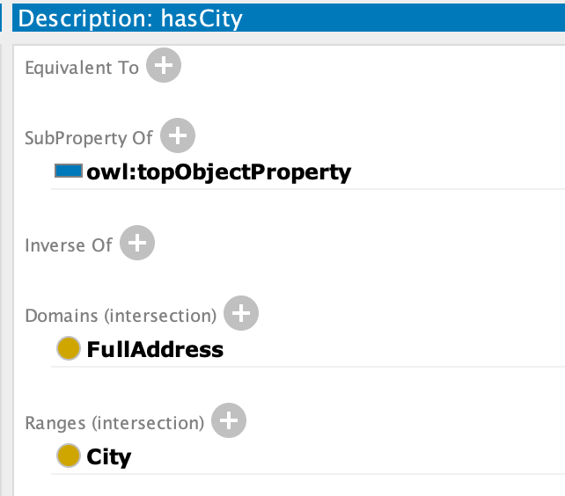

Slide 11
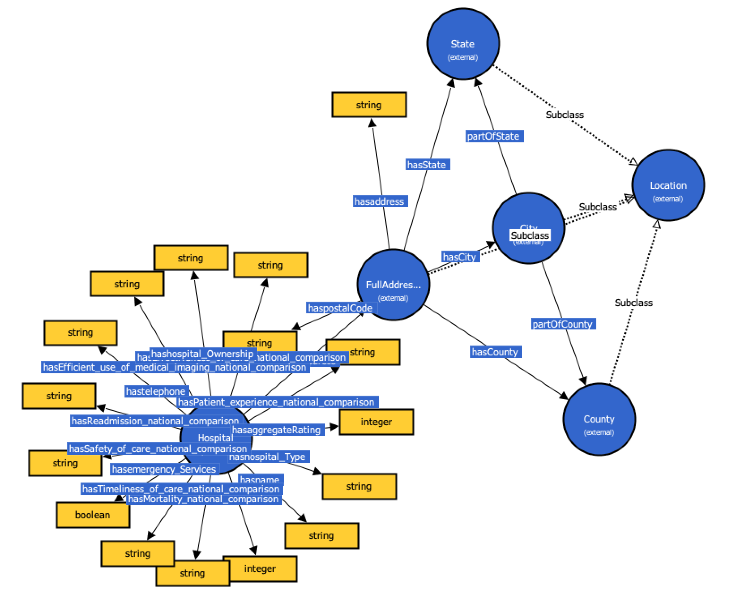

Slide 12
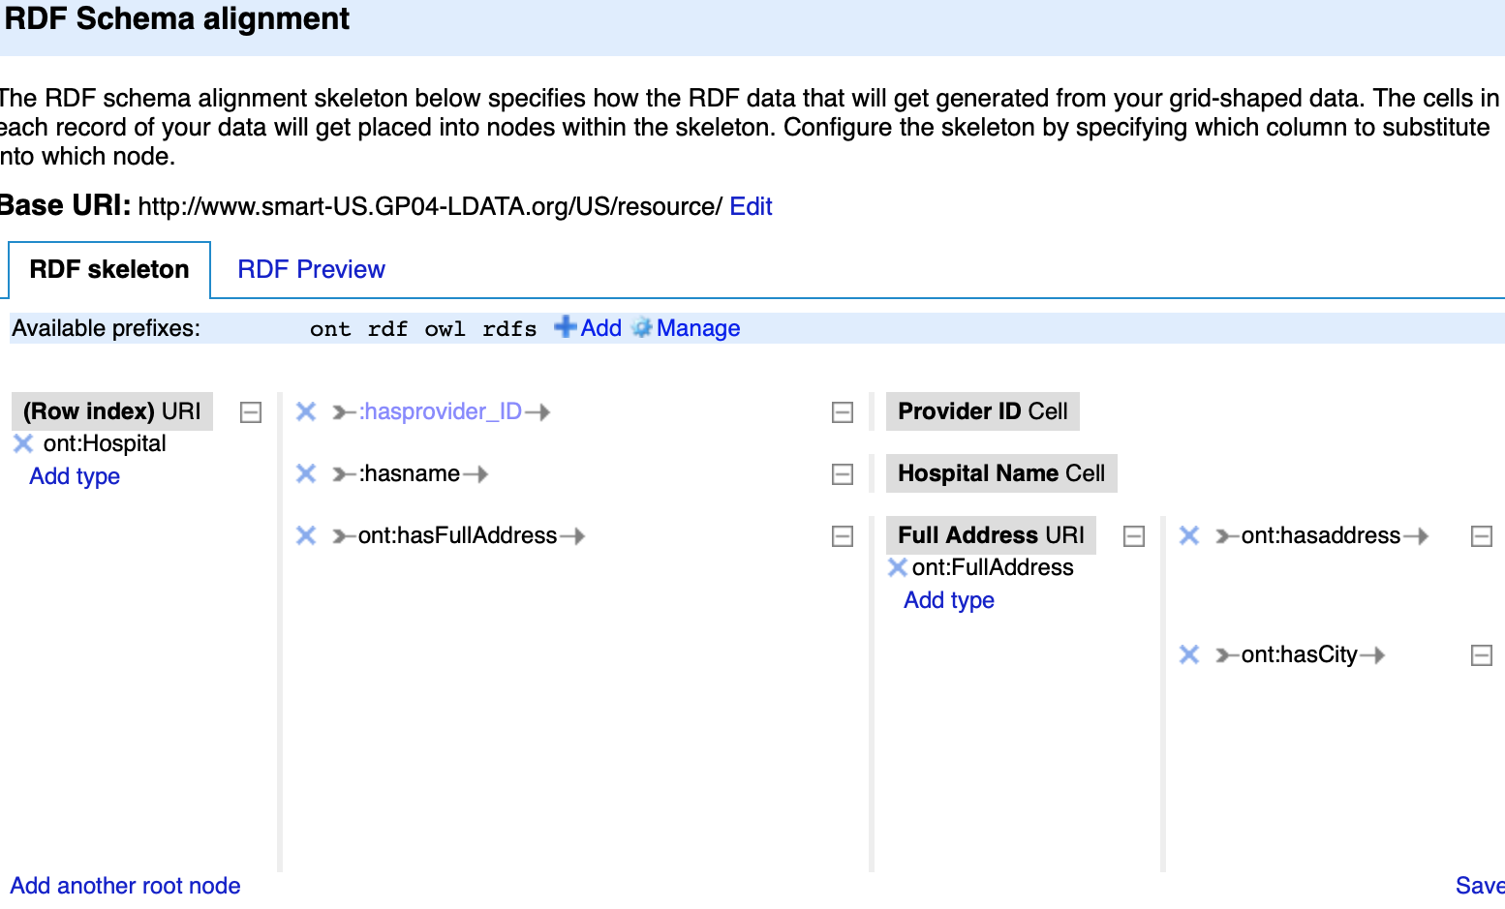
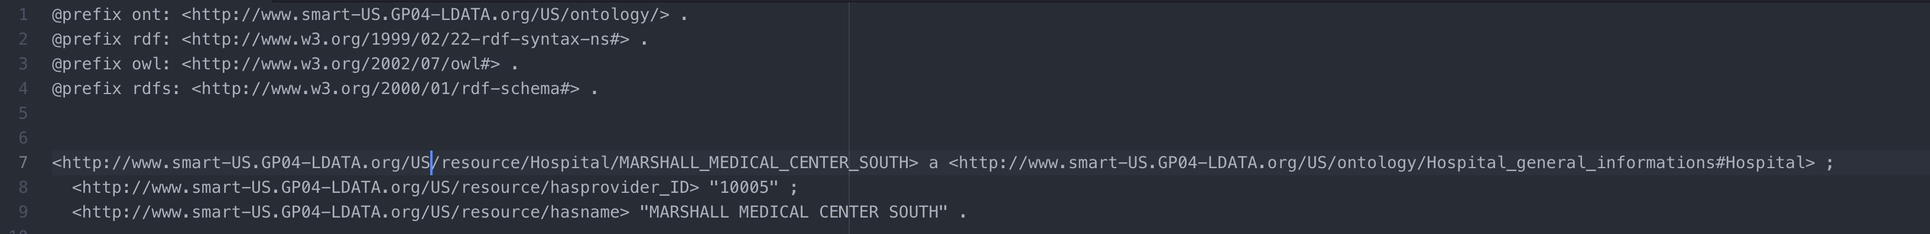
RDF
Generation

Slide 13
Data Linking
Classes with linkable instances : city, county, hospital name (not all of them)
Dataset to link to : Wikidata
Tool to use : LODRefine

Slide 14
Reconciliation

Slide 15
New RDF
Generation
With linked
data

Slide 16

APPLICATION
Notes:
Hello in This part I’m going to present our Application in fact the process and the plan we followed in the hands-on help us a lot to complete the Application ,

Slide 17
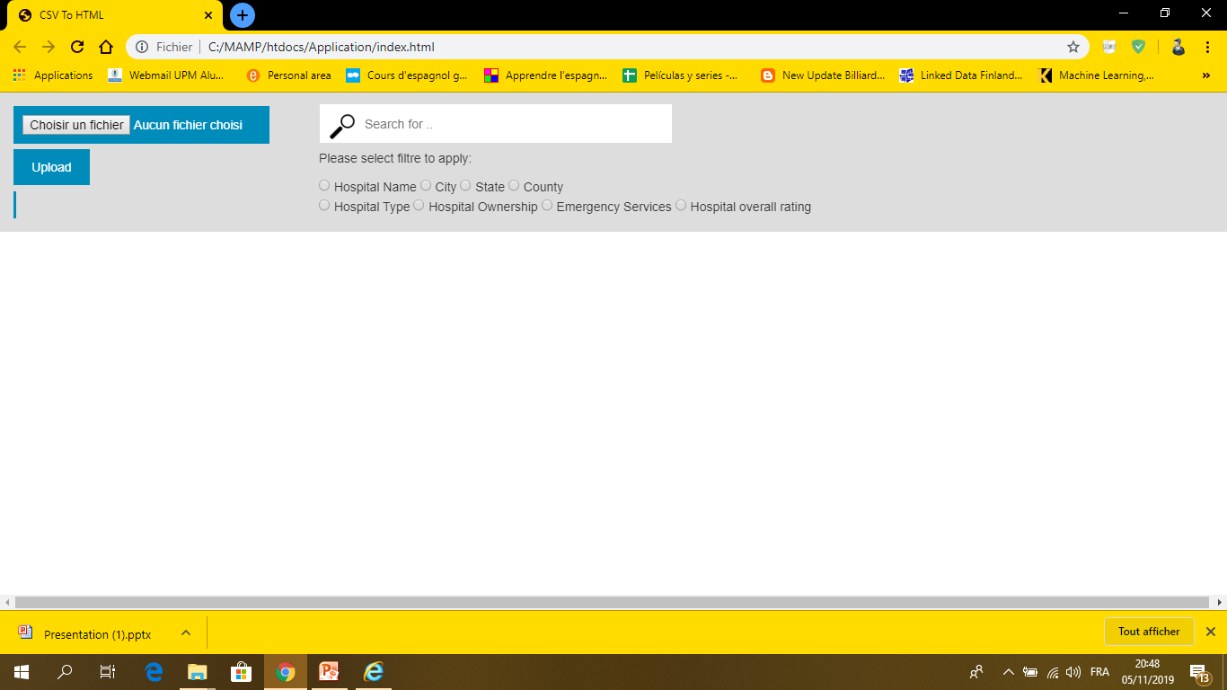

Slide 18
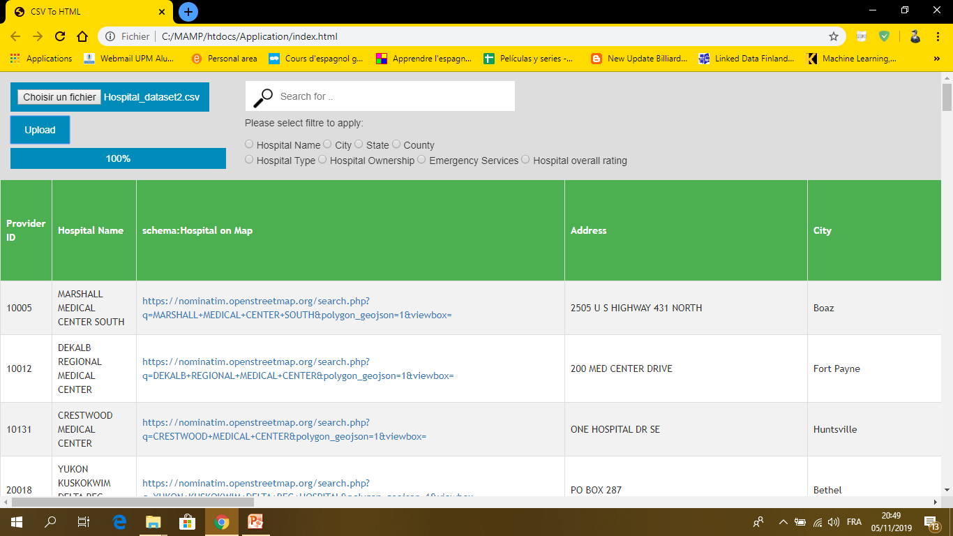

Slide 19
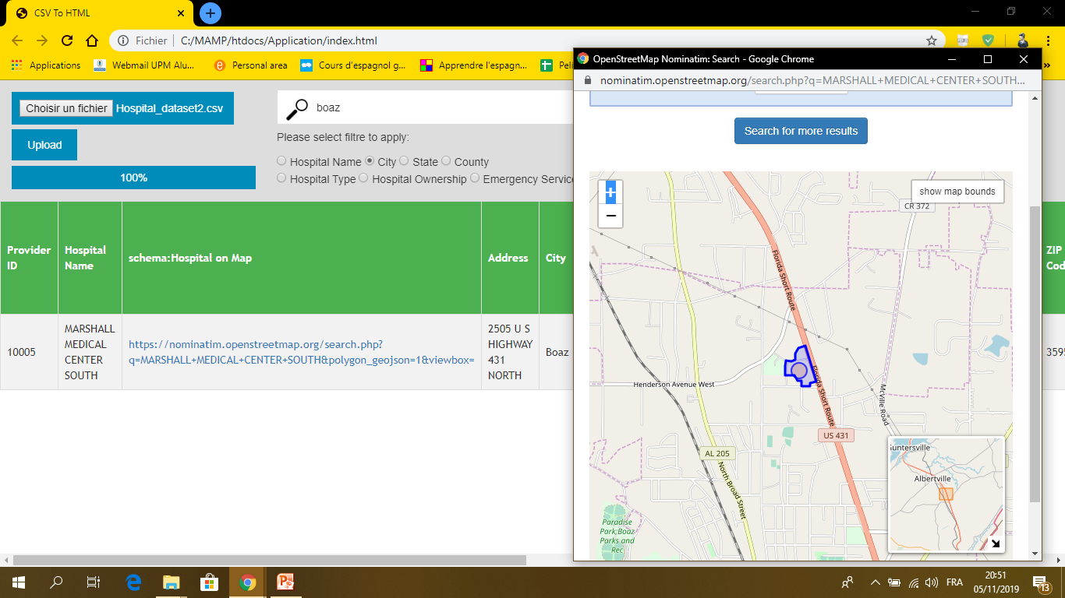

Slide 20
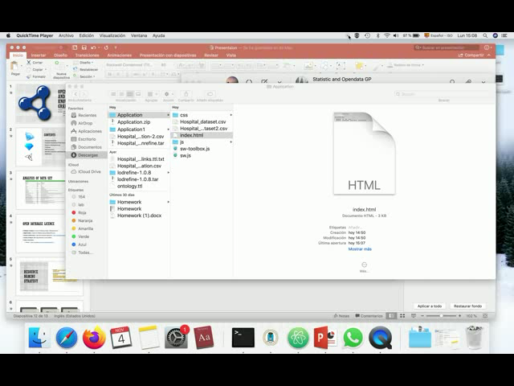
Notes:
In conclusion, This project was built through the process of accomplishing differents assignement in order to build a whole semantic web application,

Slide 21
Conclusion
Notes:
In conclusion, This project was built through the process of accomplishing differents assignement in order to build a whole semantic web application,

